Slide 1
Generic Warehouse Architecture

Slide 2
Client
Client
Query & Analysis
Design Phase
Loading
Warehouse
Metadata
Maintenance
Integrator
Optimization
Extractor/
Monitor
Extractor/
Monitor
Extractor/
Monitor
...

Slide 3
Data Warehouse Architectures: Conceptual View
Single-layer
  Every data element is stored once only
  Virtual warehouse
Two-layer
  Real-time + derived data
  Most commonly used approach in industry today
Operational
systems
Informational
systems
“Real-time data”
Operational
systems
Informational
systems
Derived Data
Real-time data

Slide 4
Three-layer Architecture: Conceptual View
Transformation of real-time data to derived data really requires two steps:
Operational
systems
Informational
systems
Data reconciliation: used to describe a verification phase during a data migration where the target data is compared against original source data to ensure that the migration architecture has transferred the data correctly.
View level
“Particular informational
needs”
Derived Data
Reconciled Data
Physical Implementation
of the Data Warehouse
Real-time data

Slide 5
Data Quality - The Reality
Tempting to think creating a data warehouse is simply extracting operational data and entering into a data warehouse
Nothing could be farther from the truth
Warehouse data comes from disparate questionable sources

Slide 6




Data Integration Across Sources
Savings
Loans
Trust
Credit card
Same data
different name
Different data
Same name
Data found here
nowhere else
Different keys
same data

Slide 7
Data Integrity Problems
Same person, different spellings
  Agarwal, Agrawal, Aggarwal etc...
Multiple ways to denote company name
  Persistent Systems, PSPL, Persistent Pvt. LTD.
Use of different names
  mumbai, bombay
Different account numbers generated by different applications for the same customer
Required fields left blank
Invalid product codes collected at point of sale
  manual entry leads to mistakes
  “in case of a problem use 9999999”

Slide 8
Data Transformation Example
Data Warehouse
appl A - m,f
appl B - 1,0
appl C - x,y
appl D - male, female
encoding
appl A - pipeline - cm
appl B - pipeline - in
appl C - pipeline - feet
appl D - pipeline - yds
unit
appl A - balance
appl B - bal
appl C - currbal
appl D - balcurr
field

Slide 9
Data Transformation Terms
Extracting
Conditioning
Scrubbing
Merging
Householding
Enrichment
Scoring
Loading
Validating
Data scrubbing is an error correction technique that uses a background task to periodically inspect main memory or storage for errors, then corrects detected errors using redundant data in the form of different checksums or copies of data.

Slide 10
Data Transformation Terms
Extracting
  Capture of data from operational source in “as is” status
Conditioning
  The conversion of data types from the source to the target data store (warehouse) -- always a relational database

Slide 11
Data Transformation Terms cont’
Householding:
  Identifying all members of a household (living at the same address)
  Ensures only one mail is sent to a household
  Can result in substantial savings:
Data validation means checking the accuracy and quality of source data before using, importing or otherwise processing data.
Data validation is a form of data cleansing.

Slide 12
Data Transformation Terms
Enrichment
  Bring data from external sources to augment/enrich operational data.
  Scoring
  Computation of a probability of an event. e.g...chance that a customer is likely to buy a new product.
Data merging is the process of combining two or more similar records into a single one.
Merging is done to add variables to a dataset, append or add cases or observations to a dataset, or remove duplicates and other incorrect information.

Slide 13
Loads
After extracting, cleaning, validating etc. need to load the data into the warehouse
Issues
  huge volumes of data to be loaded
  small time window available when warehouse can be taken off line (usually nights)
  when to build index and summary tables
  allow system administrators to monitor, cancel, resume, change load rates
  Recover gracefully -- restart after failure from where you were and without loss of data integrity

Slide 14
Refresh
Propagate updates on source data to the warehouse
Issues:
  when to refresh
  how to refresh -- refresh techniques

Slide 15
When to Refresh?
periodically (e.g., every night, every week) or after significant events
on every update: not warranted unless warehouse data require current data (up to the minute stock quotes)
refresh policy set by administrator based on user needs and traffic
possibly different policies for different sources

Slide 16
Data Extraction and Cleansing
Extract data from existing operational and legacy data
Issues:
  Sources of data for the warehouse
  Data quality at the sources
  Merging different data sources
  Data Transformation
  How to propagate updates (on the sources) to the warehouse
  Terabytes of data to be loaded

Slide 17
Granularity in Warehouse
Can not answer some questions with summarized data
  Did Anand call Seshadri last month? Not possible to answer if total duration of calls by Anand over a month is only maintained and individual call details are not.
Detailed data too voluminous
Granularity tells us about the level (high to low) of information residing in the table.
The lower the granularity is, the low-level information it contains.

Slide 18
Derived Data
Introduction of derived (calculated data) may often help
Have seen this in the context of dual levels of granularity
Can keep auxiliary views and indexes to speed up query processing
Derived data is generated from existing data using a mathematical operation or a data transformation.
OLAP Services uses SQL ROLLUP to generate aggregate data in the data warehouse.

Slide 19
Data Warehousing: Two Distinct Issues
(1) How to get information into warehouse
“Data warehousing”
(2) What to do with data once it’s in warehouse
“Warehouse DBMS”

Slide 20
Issues in Data Warehousing
Warehouse Design
Extraction
  Wrappers, monitors (change detectors)
Integration
  Cleansing & merging
Warehousing specification & Maintenance
Optimizations
Miscellaneous (e.g., evolution)

Slide 21
OLAP – Online Analytical Processing

Slide 22
OLAP – Online Analytical Processing
Online analytical processing, or OLAP is an approach to answering multi-dimensional analytical (MDA) queries swiftly.
OLAP tools enable users to analyze multidimensional data interactively from multiple perspectives.
OLAP consists of three basic analytical operations: consolidation (roll-up), drill-down, and slicing and dicing.

Slide 23
Consolidation involves the aggregation of data that can be accumulated and computed in one or more dimensions.

Slide 24
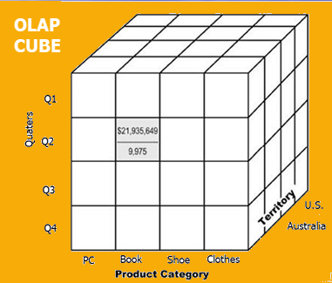
OLAP databases are divided into one or more cubes.
The cubes are designed in such a way that creating and viewing reports become easy.

Slide 25
At the core of the OLAP concept, is an OLAP Cube.
The OLAP cube is a data structure optimized for very quick data analysis.
The OLAP Cube consists of numeric facts called measures which are categorized by dimensions.
OLAP Cube is also called the hypercube.

Slide 26
How does it work?
A Data warehouse would extract information from multiple data sources and formats like text files, excel sheet, multimedia files, etc.
The extracted data is cleaned and transformed.
Data is loaded into an OLAP server (or OLAP cube) where information is pre-calculated in advance for further analysis.

Slide 27
Basic analytical operations of OLAP (we shall the details later)
Four types of analytical operations in OLAP are:
Roll-up
Drill-down
Slice and dice
Pivot (rotate)

Slide 28
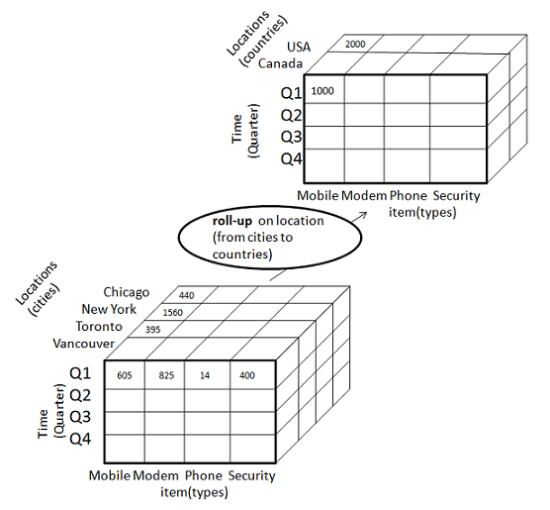
Roll-up
Roll-up performs aggregation on a data cube in any of the following ways −
By climbing up a concept hierarchy for a dimension
By dimension reduction
The following diagram illustrates how roll-up works.
Initially the concept hierarchy was "street < city < province < country".
On rolling up, the data is aggregated by ascending the location hierarchy from the level of city to the level of country.
The data is grouped into cities rather than countries.

Slide 29
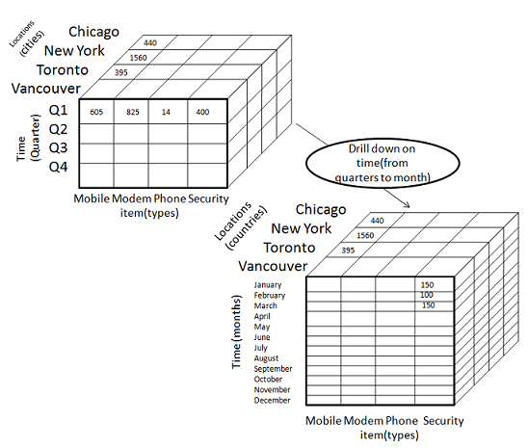
Drill-down
Drill-down is the reverse operation of roll-up. It is performed by either of the following ways −
By stepping down a concept hierarchy for a dimension
By introducing a new dimension.
The following diagram illustrates how drill-down works −
Drill-down is performed by stepping down a concept hierarchy for the dimension time.
Initially the concept hierarchy was "day < month < quarter < year."
On drilling down, the time dimension is descended from the level of quarter to the level of month.

Slide 30
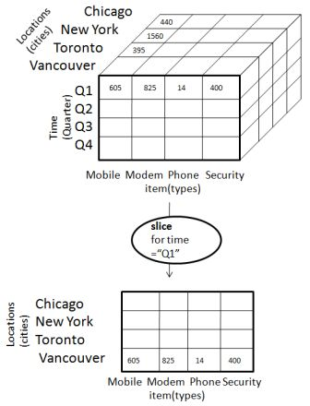
Slice
The slice operation selects one particular dimension from a given cube and provides a new sub-cube. Consider the following diagram that shows how slice works.
Here Slice is performed for the dimension "time" using the criterion time = "Q1".
It will form a new sub-cube by selecting one or more dimensions.

Slide 31
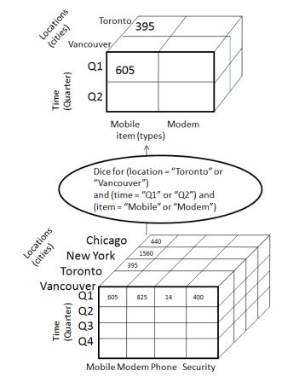
Dice
Dice selects two or more dimensions from a given cube and provides a new sub-cube. Consider the following diagram that shows the dice operation.
The dice operation on the cube based on the following selection criteria involves three dimensions.
(location = "Toronto" or "Vancouver")
(time = "Q1" or "Q2")
(item =" Mobile" or "Modem")

Slide 32
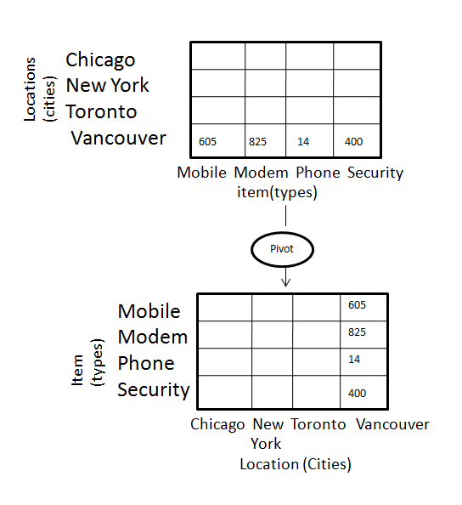
Pivot
The pivot operation is also known as rotation. It rotates the data axes in view in order to provide an alternative presentation of data. Consider the following diagram that shows the pivot operation.

Slide 33
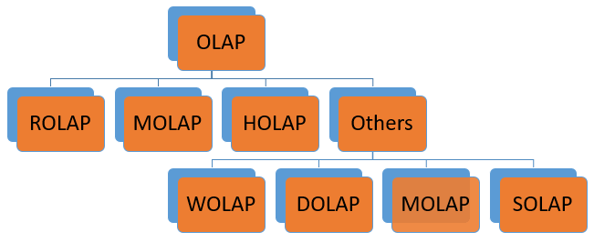
Types of OLAP systems
OLAP Hierarchical Structure

Slide 34
Type of OLAP | Explanation
Relational OLAP(ROLAP): | ROLAP is an extended RDBMS along with multidimensional data mapping to perform the standard relational operation.
Multidimensional OLAP (MOLAP) | MOLAP Implements operation in multidimensional data.
Hybrid Online Analytical Processing (HOLAP) | In HOLAP approach the aggregated totals are stored in a multidimensional database while the detailed data is stored in the relational database. This offers both data efficiency of the ROLAP model and the performance of the MOLAP model.
Desktop OLAP (DOLAP) | In Desktop OLAP, a user downloads a part of the data from the database locally, or on their desktop and analyze it. DOLAP is relatively cheaper to deploy as it offers very few functionalities compares to other OLAP systems.
Web OLAP (WOLAP) | Web OLAP which is OLAP system accessible via the web browser. WOLAP is a three-tiered architecture. It consists of three components: client, middleware, and a database server.
Mobile OLAP: | Mobile OLAP helps users to access and analyze OLAP data using their mobile devices
Spatial OLAP : | SOLAP is created to facilitate management of both spatial and non-spatial data in a Geographic Information system (GIS)

Slide 35
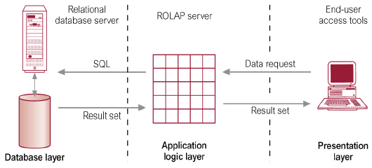
ROLAP
ROLAP works with data that exist in a relational database.
Facts and dimension tables are stored as relational tables.
It also allows multidimensional analysis of data and is the fastest growing OLAP.
Relational OLAP(ROLAP)

Slide 36
Advantages of ROLAP model:
High data efficiency: It offers high data efficiency because query performance and access language are optimized particularly for the multidimensional data analysis.
Scalability. This type of OLAP system offers scalability for managing large volumes of data, and even when the data is steadily increasing.

Slide 37
Drawbacks of ROLAP model:
Demand for higher resources: ROLAP needs high utilization of manpower, software, and hardware resources.
Aggregately data limitations. ROLAP tools use SQL for all calculation of aggregate data. However, there are no set limits to the for handling computations.
Slow query performance. Query performance in this model is slow when compared with MOLAP

Slide 38
Multidimensional OLAP (MOLAP)
It is a classical OLAP that facilitates data analysis by using a multidimensional data cube.
Data is pre-computed, re-summarized, and stored in a MOLAP (a major difference from ROLAP).
Using a MOLAP, a user can use multidimensional view data with different facets.
Facts are stored in multi-dimensional array and dimensions used to query them.
Basically, they use an OLAP cube.

Slide 39
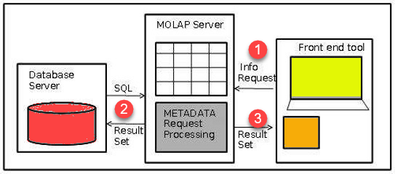
MOLAP Architecture
MOLAP Architecture includes the following components ?
Database server.
MOLAP server.
Front-end tool.

Slide 40
The user request reports through the interface
The application logic layer of the MDDB retrieves the stored data from Database
The application logic layer forwards the result to the client/user.
MOLAP architecture mainly reads the precompiled data.
MOLAP architecture has limited capabilities to dynamically create aggregations or to calculate results that have not been pre-calculated and stored.
For example, an accounting head can run a report showing the corporate P/L account or P/L account for a specific subsidiary.
The MDDB would retrieve precompiled Profit & Loss figures and display that result to the user.

Slide 41
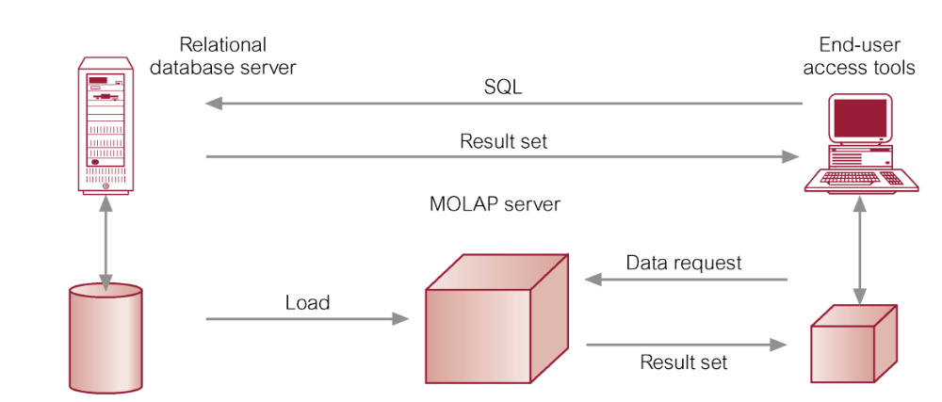
Hybrid OLAP
Hybrid OLAP is a mixture of both ROLAP and MOLAP.
It offers fast computation of MOLAP and higher scalability of ROLAP. HOLAP uses two databases:
Aggregated or computed data is stored in a multidimensional OLAP cube
Detailed information is stored in a relational database.

Slide 42
Benefits of Hybrid OLAP
This kind of OLAP helps to economize the disk space, and it also remains compact which helps to avoid issues related to access speed and convenience.
Hybrid HOLAP's uses cube technology which allows faster performance for all types of data.
ROLAP are instantly updated and HOLAP users have access to this real-time instantly updated data.
MOLAP brings cleaning and conversion of data thereby improving data relevance. This brings best of both worlds.

Slide 43
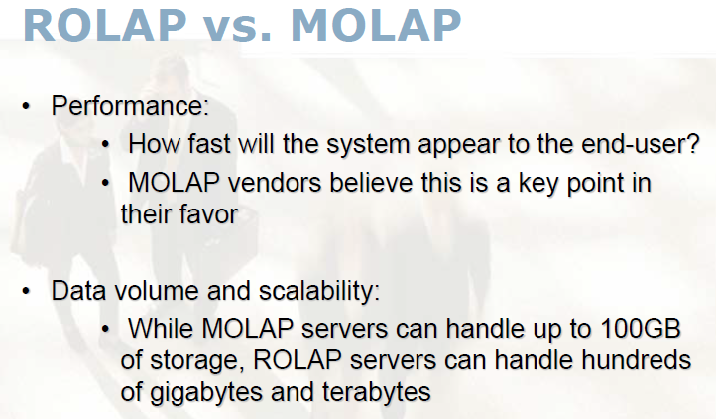
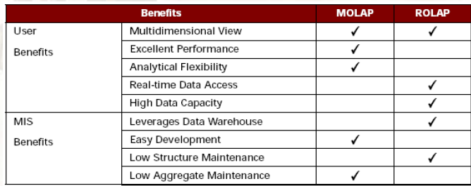

Slide 44
Summary cont’:
OLAP is a technology that enables analysts to extract and view business data from different points of view.
At the core of the OLAP concept, is an OLAP Cube.
Various business applications and other data operations require the use of OLAP Cube.
There are primary five types of analytical operations in OLAP
1) Roll-up 2) Drill-down 3) Slice 4) Dice and 5) Pivot
Three types of widely used OLAP systems are MOLAP, ROLAP, and Hybrid OLAP.
Desktop OLAP, Web OLAP, and Mobile OLAP are some other types of OLAP systems.

Slide 45
OLTP – Online Transaction Processing

Slide 46
OLTP is an operational system that supports transaction-oriented applications in a 3-tier architecture.
It administers the day-to-day transaction of an organization.
OLTP is basically focused on query processing, maintaining data integrity in multi-access environments as well as effectiveness that is measured by the total number of transactions per second.
The full form of OLTP is Online Transaction Processing.

Slide 47
Characteristics of OLTP
OLTP uses transactions that include small amounts of data.
Indexed data in the database can be accessed easily.
OLTP has a large number of users.
It has fast response times.
Databases are directly accessible to end-users
OLTP uses a fully normalized schema for database consistency.
The response time of OLTP system is short.
It strictly performs only the predefined operations on a small number of records.
OLTP stores the records of the last few days or a week.
It supports complex data models and tables.

Slide 48
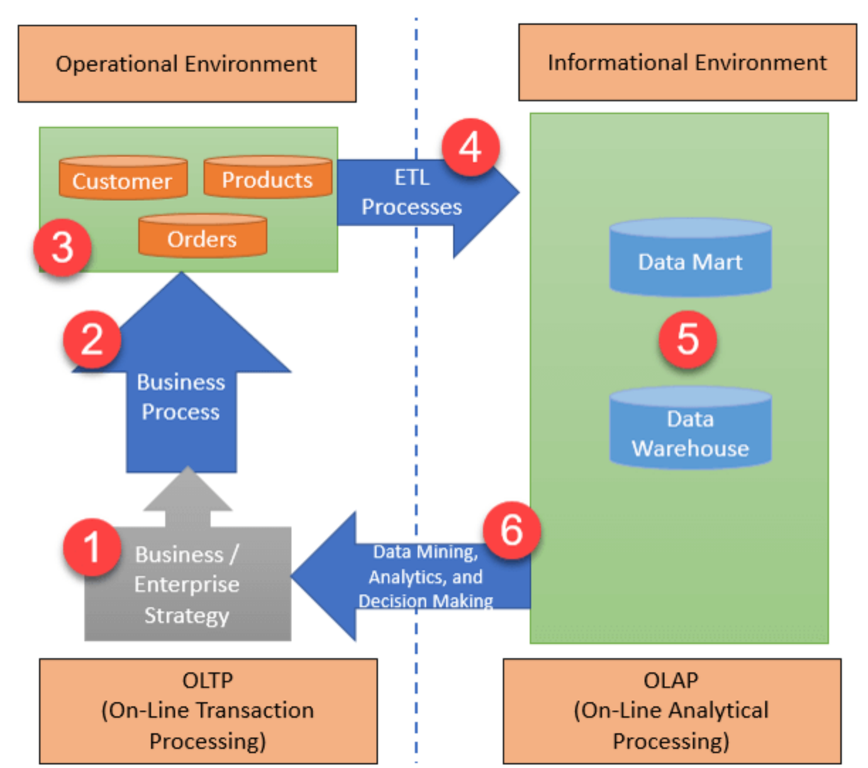
Architecture of OLTP

Slide 49
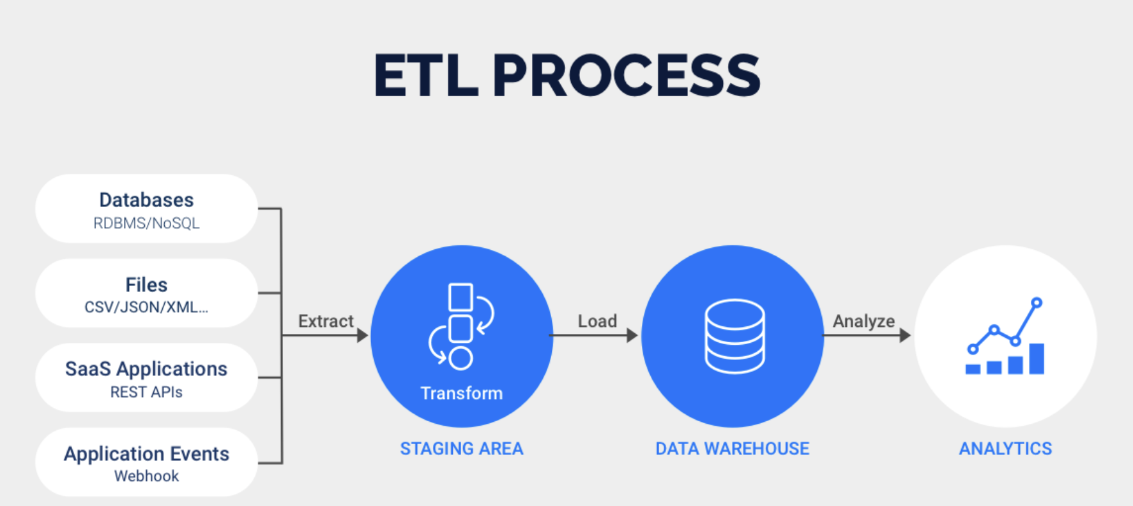
ETL Processes

Slide 50
Business / Enterprise Strategy:
Enterprise strategy deals with the issues that affect the organization as a whole.
In OLTP, it is typically developed at a high level within the firm, by the board of directors or the top management
Business Process:
OLTP business process is a set of activities and tasks that, once completed, will accomplish an organizational goal.
Customers, Orders, and Products:
OLTP database store information about products, orders (transactions), customers (buyers), suppliers (sellers), and employees.

Slide 51
ETL Processes:
It separates the data from various RDBMS source systems, then transforms the data (like applying concatenations, calculations, etc.) and loads the processed data into the Data Warehouse system.
Data Mart and Data warehouse:
A data mart is a structure/access pattern specific to data warehouse environments. It is used by OLAP to store processed data.
Data Mining, Analytics, and Decision Making:
Data stored in the data mart and data warehouse can be used for data mining, analytics, and decision making.
This data helps you to discover data patterns, analyze raw data, and make analytical decisions for your organization's growth.

Slide 52

Example of OLTP Transaction
An example of the OLTP system is the ATM center.
Other examples of OLTP system are:
Online banking
Online airline ticket booking
Sending a text message
Order entry
Add a book to shopping cart
ATM image

Slide 53
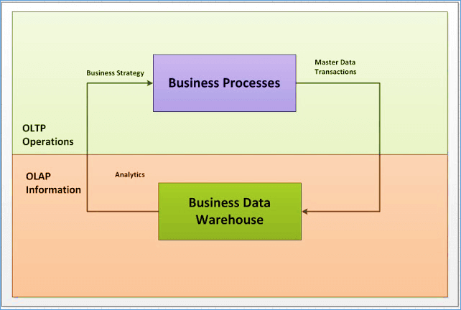
OLTP vs. OLAP (Summary)

Slide 54
Data Warehouse vs. Data Marts
What comes first?

Slide 55
From the Data Warehouse to Data Marts
Information
Individually
Structured
Less
History
Normalized
Detailed
Departmentally
Structured
Data Warehouse
Organizationally
Structured
More
Data

Slide 56
Data Warehouse and Data Marts
OLAP
Data Mart
Lightly summarized
Departmentally structured
Organizationally structured
Atomic
Detailed Data Warehouse Data

Slide 57
Characteristics of the Departmental Data Mart
OLAP
Small
Flexible
Customized by Department
Source is departmentally structured data warehouse

Slide 58
Techniques for Creating Departmental Data Mart
OLAP
Subset
Summarized
Superset
Indexed
Arrayed
Sales
Finance
Mktg.

Slide 59
Data Mart Centric
Data Sources
Data Marts
Data Warehouse

Slide 60
Problems with Data Mart Centric Solution
If you end up creating multiple warehouses, integrating them is a problem

Slide 61
OLAP Is FASMI cont’
Fast
Analysis
Shared
Multidimensional
Information
Fast Analysis of Shared Multidimentional Information is an alternative term of OLAP
Nigel Pendse, Richard Creath - The OLAP Report

Slide 62
Multi-dimensional Data
“Hey…I sold $100M worth of goods”
Dimensions: Product, Region, Time
Hierarchical summarization paths
Product Region Time
Industry Country Year
Category Region Quarter
Product City Month Week
Office Day
Region
W
S
N
Juice
Product
Cola
Milk
Cream
Toothpaste
Soap
1
2
3
4
5
6
7
Month

Slide 63
A Visual Operation: Pivot (Rotate)
NY
LA
SF
Month
Juice
Cola
Milk
Cream
10
Region
47
30
12
Product
3/1 3/2 3/3 3/4
Date

Slide 64
“Slicing and Dicing”
Slicing: Here, one dimension is selected, and a new sub-cube is created.
Dicing:
This operation is similar to a slice.
The difference in dice is you select 2 or more dimensions that result in the creation of a sub-cube.
The Telecomm Slice
Product
Household
Telecomm
Regions
Video
Europe
Far East
Audio
India
Retail
Direct
Special
Sales Channel

Slide 65
Roll-up and Drill Down
Higher Level of
Aggregation
Sales Channel
Region
Country
State
Location Address
Sales Representative
Drill-Down
Roll Up
Low-level
Details

Slide 66
Data Warehouse Pitfalls
You are going to spend much time extracting, cleaning, and loading data
You are going to find problems with systems feeding the data warehouse
You will find the need to store data not being captured by any existing system
You will need to validate data not being validated by transaction processing systems

Slide 67
Data Warehouse Pitfalls
Some transaction processing systems feeding the warehousing system will not contain detail
Many warehouse end users will be trained and never or seldom apply their training
Your warehouse users will develop conflicting business rules

Slide 68
Data Warehouse Pitfalls
'Overhead' can eat up great amounts of disk space
The time it takes to load the warehouse will expand to the amount of the time in the available window..
Assigning security cannot be done with a transaction processing system mindset.
You are building a HIGH maintenance system.
You will fail if you concentrate on resource optimization to the neglect of project, data, and customer management issues and an understanding of what adds value to the customer

Slide 69
DW and OLAP Research Issues
Data cleaning
  focus on data inconsistencies, not schema differences
  data mining techniques
Physical Design
  design of summary tables, partitions, indexes
  tradeoffs in use of different indexes
Query processing
  selecting appropriate summary tables
  dynamic optimization with feedback
  acid test for query optimization: cost estimation, use of transformations, search strategies
  partitioning query processing between OLAP server and backend server.

Slide 70
DW and OLAP Research Issues .. 2
Warehouse Management
  detecting runaway queries
  resource management
  incremental refresh techniques
  computing summary tables during load
  failure recovery during load and refresh
  process management: scheduling queries, load and refresh
  Query processing, caching
  use of workflow technology for process management

Slide 71
Data Warehouse (References)
W.H. Inmon, Building the Data Warehouse, Second Edition, John Wiley and Sons, 1996
W.H. Inmon, J. D. Welch, Katherine L. Glassey, Managing the Data Warehouse, John Wiley and Sons, 1997
Barry Devlin, Data Warehouse from Architecture to Implementation, Addison Wesley Longman, Inc 1997

Slide 72
Data Warehouse (References)
W.H. Inmon, John A. Zachman, Jonathan G. Geiger, Data Stores Data Warehousing and the Zachman Framework, McGraw Hill Series on Data Warehousing and Data Management, 1997
Ralph Kimball, The Data Warehouse Toolkit, John Wiley and Sons, 1996

Slide 73
OLAP and DSS
Erik Thomsen, OLAP Solutions, John Wiley and Sons 1997
Microsoft TechEd Transparencies from Microsoft TechEd 98

Slide 74
Data Mining
Michael J.A. Berry and Gordon Linoff, Data Mining Techniques, John Wiley and Sons 1997
Peter Adriaans and Dolf Zantinge, Data Mining, Addison Wesley Longman Ltd. 1996

Slide 75
Other Tutorials
Donovan Schneider, Data Warehousing Tutorial, Tutorial at International Conference for Management of Data (SIGMOD 1996) and International Conference on Very Large Data Bases 97
Umeshwar Dayal and Surajit Chaudhuri, Data Warehousing Tutorial at International Conference on Very Large Data Bases 1996
Anand Deshpande and S. Seshadri, Tutorial on Datawarehousing and Data Mining, CSI-97

Slide 76
Useful URLs
Data Warehousing
  https://www.tutorialspoint.com/dwh/index.htm
  OLAP
  https://www.tutorialspoint.com/dwh/index.htm

